Slide 1
THEORY OF COMPUTATION
-TOPIC-
MINIMIZATION OF FINITE AUTOMATA

Slide 2
Minimization of DFA
Minimization of DFA means reducing the number of states from given FA.
Thus, we get the FSM(finite state machine) with redundant states after minimizing the FSM.

Slide 3
Steps:
Step1: Identify the given number of states.
Step2:Draw the upper triangular matrix for the given problem.
Step3:Draw the table filling format to mark the state
reachable to final state.
Step4:Draw the transition table for unmarked states.
Step5:Draw the table filling format to mark the respective
cells from the above transition table.
Step6:The final unmarked states.
Note: The states which are reachable to final state can be marked ,If its already
marked then consider the respective cell value for marking.
If the both values reachable to final state then it cant be consider for marking.

Slide 4
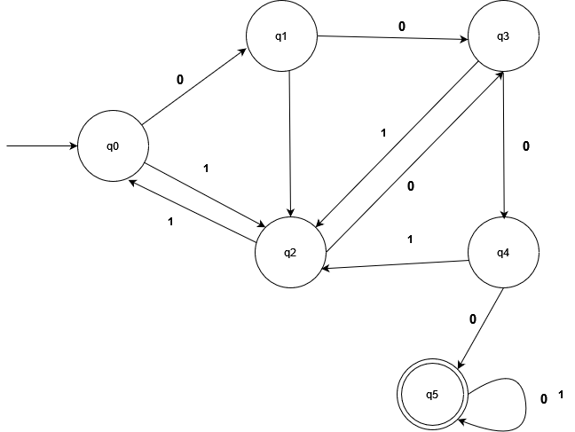
Problem:
1
Initial/Start
state
Final state

Slide 5
Step1:Identify the given number of states.
The given states are:
{q₀, q₁, q₂, q₃, q₄, q₅}

Slide 6
Step2: Draw the upper triangular matrix for the given problem.
(q₀, q₁)
(q₀, q₂)
(q₀, q₃)
(q₀, q₄)
(q₀, q₅) (✔)
q₁, q₂)
(q₁, q₃)
(q₁, q₄)
(q₁, q₅) (✔)
(q₂, q₃)
(q₂, q₄)
(q₂, q₅) (✔)
(q₃, q₄)
(q₃, q₅) (✔)
(q₄, q₅) (✔)

Slide 7
Step3:Draw the table filling format to mark the state reachable to final state.
q₁ | ?
q₂ | ? | ?
q₃ | ? | ? | ?
q₄ | ? | ? | ? | ?
q₅ | X | X | X | X | X
 | q₀ | q₁ | q₂ | q₃ | q₄

Slide 8
Step4: Draw the transition table for unmarked states.
δ | 0 | 1
(q₀, q₁) | (q₁, q₃) | (q₁, q₂)
(q₀, q₂) | (q₁, q₃) | (q2,q0)
(q₀, q₃) | (q₁, q₂) | (q₂, q₂)
(q₀, q₄) | (q₁, q₅) (✔) | (q₂, q₂)
(q₁, q₂) | (q₂, q₃) | (q₂, q₀)
(q₁, q₃) | (q₃, q₄) | (q₂, q₂)
(q₁, q₄) | (q₃, q₅) (✔) | (q₂, q₂)
(q₂, q₃) | (q₃, q₄) | (q₀, q₂)
(q₂, q₄) | (q₃, q₅)(✔) | (q₀, q₂)
(q₃, q₄) | (q₄, q₅)(✔) | (q₂, q₂)

Slide 9
Step5:Draw the table filling format to mark the respective cells from the above transition table.
q₁ | ?
q₂ | ? | ?
q₃ | ? | ? | ?
q₄ | X | X | X | X
q₅ | X | X | X | X | X
 | q₀ | q₁ | q₂ | q₃ | q₄

Slide 10
Step6:The final unmarked states.
The unmarked states are,
(q₀, q₁) | (q₀, q₂) | (q₀, q₃) | (q₁, q₂) | (q₁, q₃) | (q₂, q₃)
The total number of state 6 not reduce remain it same

